Slide 1
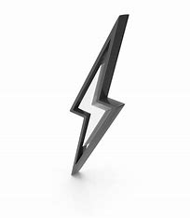
SPARKATHON 2025
Sparkle
SMART WIND TURBINE WITH AI - BASED EFFICIENCY OPTIMIZATION
Problem Statement ID : PEC0025​
Problem Statement Title: Smart Wind Turbine with AI-based Efficiency Optimization​
Theme: AI-Driven optimization industry 4.0​
PS Category: Hardware​
Team Name: Sparkle
SPARKATHON
1

Slide 2
Key Considerations for Smart Wind Turbine
Design and Structure
Aerodynamic Blade Design: Optimized for maximum efficiency, reducing drag and increasing power generation.
Structural Integrity: Designed with lightweight yet durable materials (e.g., carbon fiber, reinforced composites) to withstand harsh weather.
Adaptive Blade Mechanism: Blades adjust their angle (pitch control) based on wind conditions to maximize efficiency.
Self-Healing Coatings: Protective materials that reduce wear and tear, increasing longevity.
Power and Payload
AI-Based Efficiency Optimization: Uses machine learning to adjust turbine speed and blade angles based on real-time wind data. Battery Storage System: Lithium-ion or solid-state batteries store excess energy for later use.
Hybrid Power Sources: Integrated solar panels can supplement energy during low-wind conditions.
Regenerative Braking System: Converts excess kinetic energy into stored power when winds are too strong.
Navigation
Remote Monitoring: IoT-based sensors provide real-time data on performance, wind conditions, and maintenance needs.
AI-Driven Predictive Maintenance: Detects wear and predicts potential failures before they occur.
Obstacle Detection & Avoidance: Uses LiDAR or IR sensors to prevent collisions with birds or drones. GPS Tracking & Positioning: Ensures optimal placement in offshore or onshore wind farms.
Stability
Vibration Control Mechanisms: Sensors detect imbalances and adjust rotation to reduce structural stress.
Gyroscopic Stabilization: Helps maintain balance during turbulent weather.
Lightning Protection System: Prevents damage from electrical surges caused by lightning strikes. Automated Emergency Shutoff: Detects extreme conditions (e.g., hurricane winds) and stops the turbine to prevent damage.4. Navigation and IoT Connectivity
Cost and Scalability
Modular Design: Components can be replaced individually to reduce maintenance costs.
3D-Printed Parts: Reduces production costs and enables rapid prototyping.
Scalable Battery Storage: Allows expansion to accommodate larger wind farms.
Grid Integration: Smart-grid compatibility to optimize energy distribution.
Communication System and Safety
Mobile & Web App Integration: Allows remote monitoring and control of turbine performance. Wireless Sensor Network: Communicates with nearby turbines for synchronized operation.
Color Light Indicators: Alerts technicians about system status (e.g., low battery, maintenance required).
Emergency Alerts & AI Diagnostics: Sends real-time alerts and suggests solutions for detected issues.
SPARKATHON
2

Slide 3
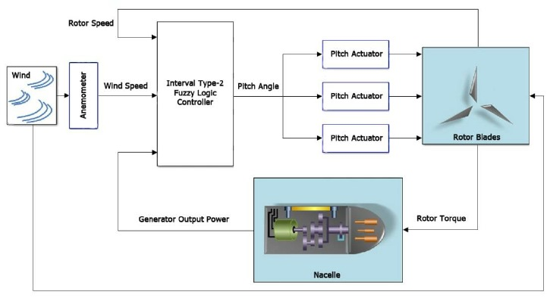
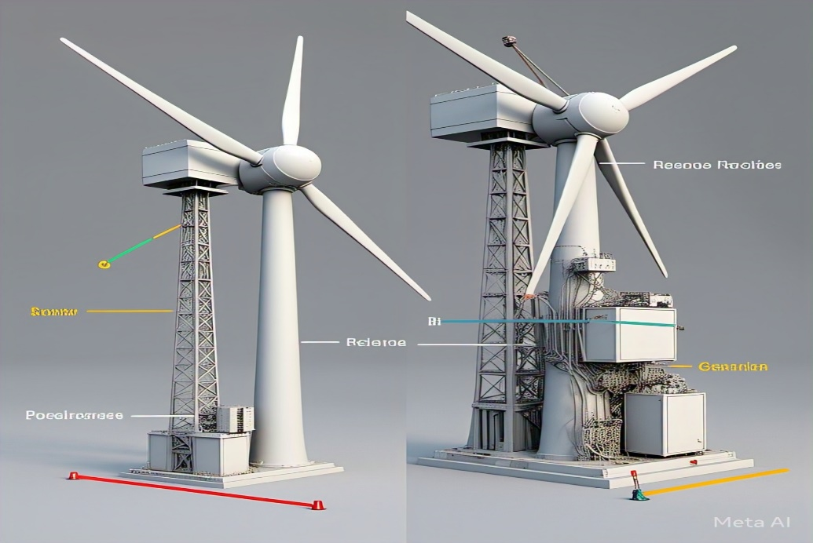
SMART WIND TURBINE
The Wind turbine is a Smart turbine which feature various technologies to make it work totally smart and independent operating.
The design of Turbine frame is smart and provides structural strength, while its body design ensures efficient in wind.
SENSORS:
Wind Speed → Anemometer → Optimizes blade speed for maximum efficiency. Wind Direction → Wind Vane → Adjusts yaw angle to align with wind flow. Temperature & Humidity → Thermocouple, Hygrometer → Predicts air density for better power estimation. Blade Angle (Pitch Control) → Encoder, Potentiometer → Dynamically adjusts blade pitch for optimal performance. Vibration Monitoring → Accelerometer → Detects mechanical stress and potential faults. Power Output Monitoring → Current/Voltage Sensor →Measures energy generation efficiency.
The turbine incorporates AI and IoT powered by a which processes data and communicates with other devices in real-time for optimal performance. Being integrated with IoT, the system's data is screened via a user-friendly interface.
Smart wind turbines use mechanical, electrical, and environmental protection, along with cybersecurity measures for safe and reliable operation.
Smart wind turbines are equipped with AI-driven control systems, IoT sensors, real-time monitoring, pitch/yaw adjustment, braking systems, surge protection, de-icing mechanisms, and cybersecurity features for optimal performance and safety.
The Smart turbine includes four key interchangeable add-ons:
Battery Storage Modules → Integrate supercapacitors or lithium-ion batteries for energy storage.
Aerodynamic Blade Upgrades → Adjustable or flexible blades for efficiency.
Noise Reduction Systems → Acoustic dampers to minimize turbine noise.
Hybrid Energy Integration → Solar panels on turbine towers for extra power.
FLOW CHART
3D design of wind turbine
3

Slide 4
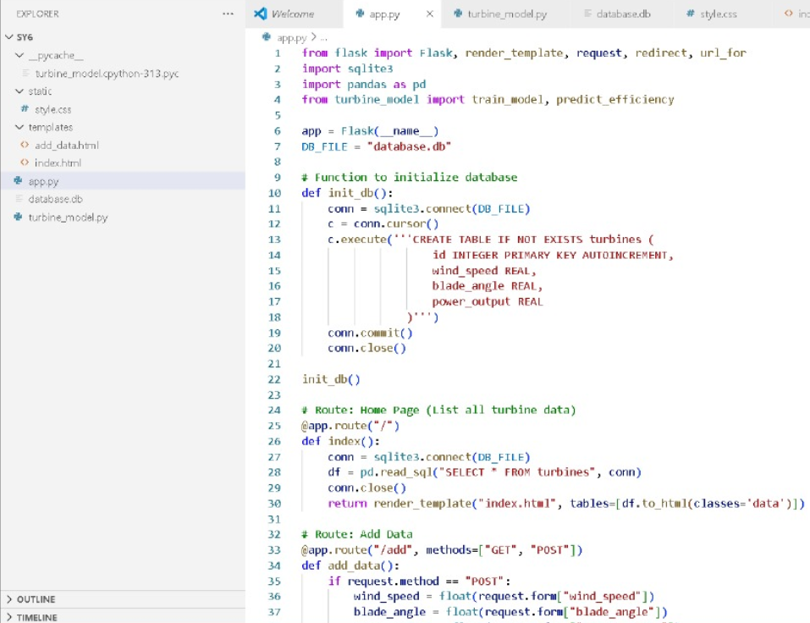
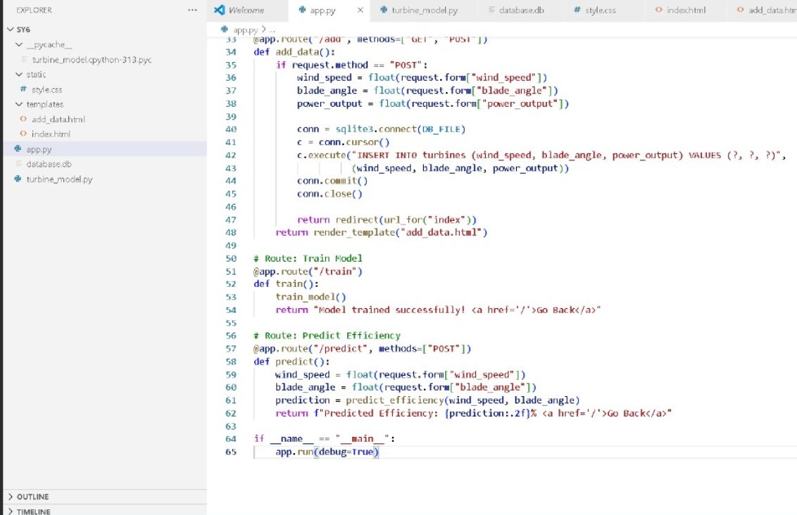
MACHINE LEARNING APPROACH
4

Slide 5
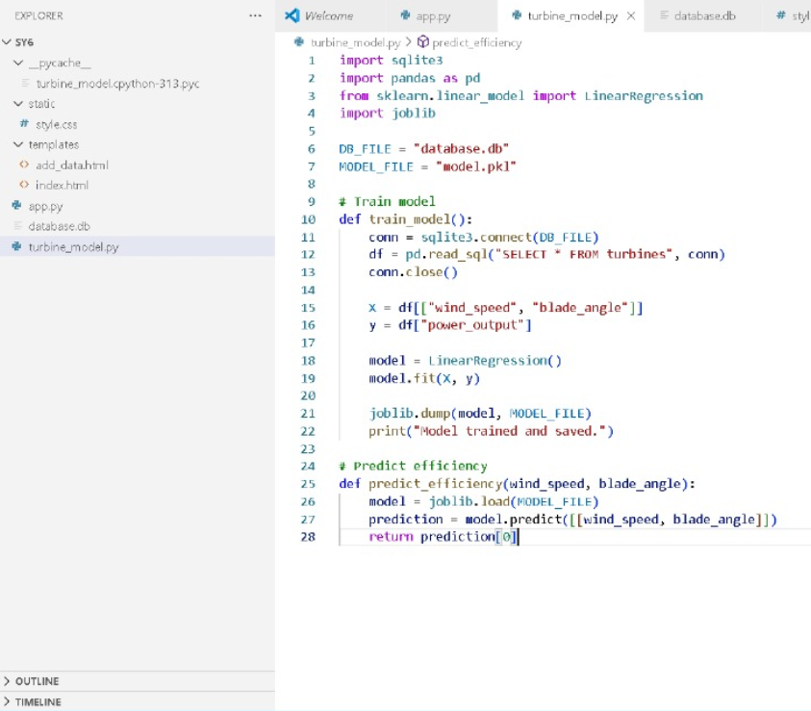
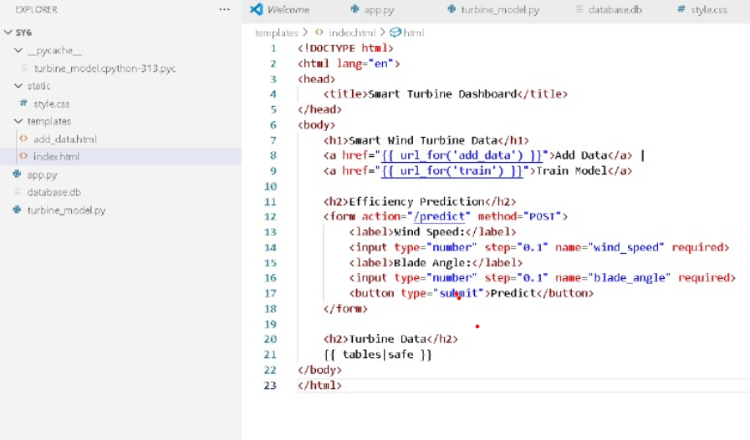
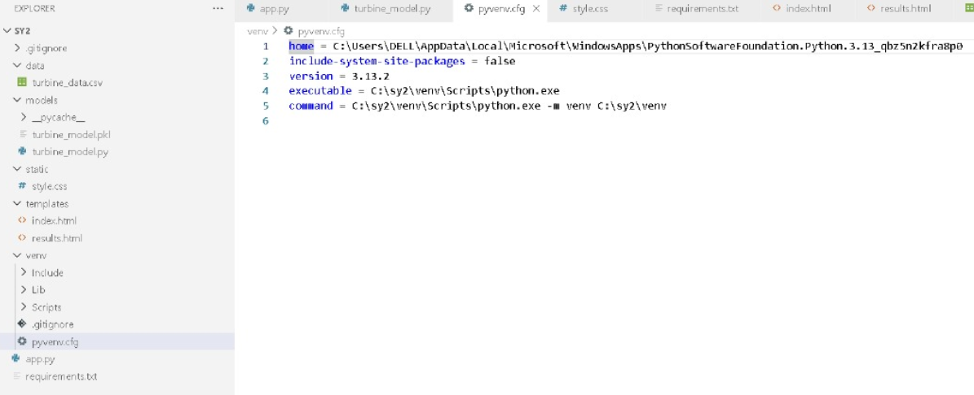
SPARKATHON
5

Slide 6
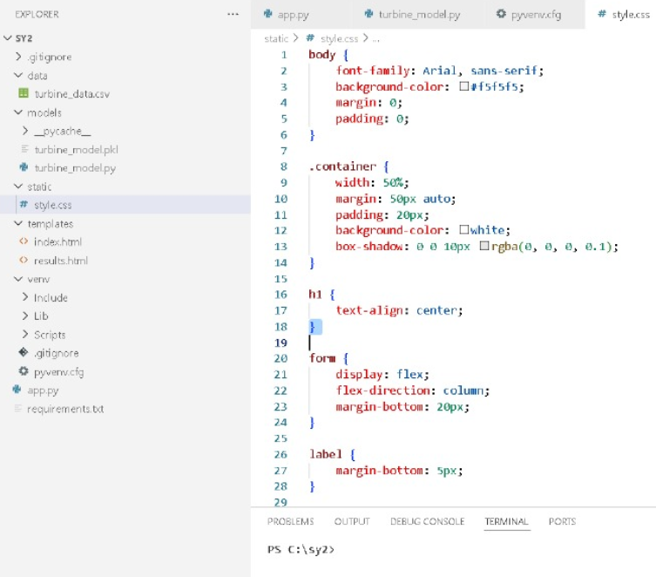
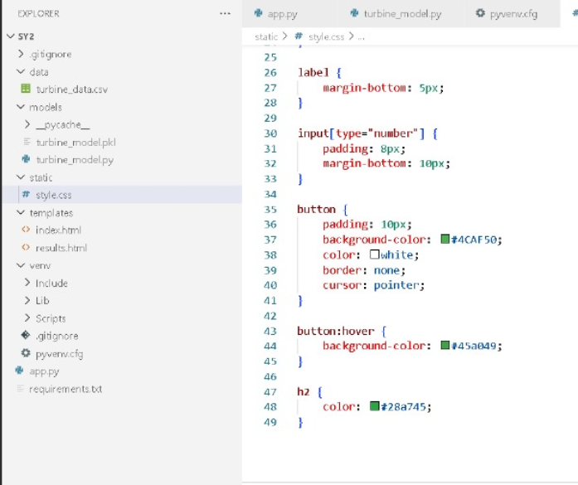
SPARKATHON
6

Slide 7
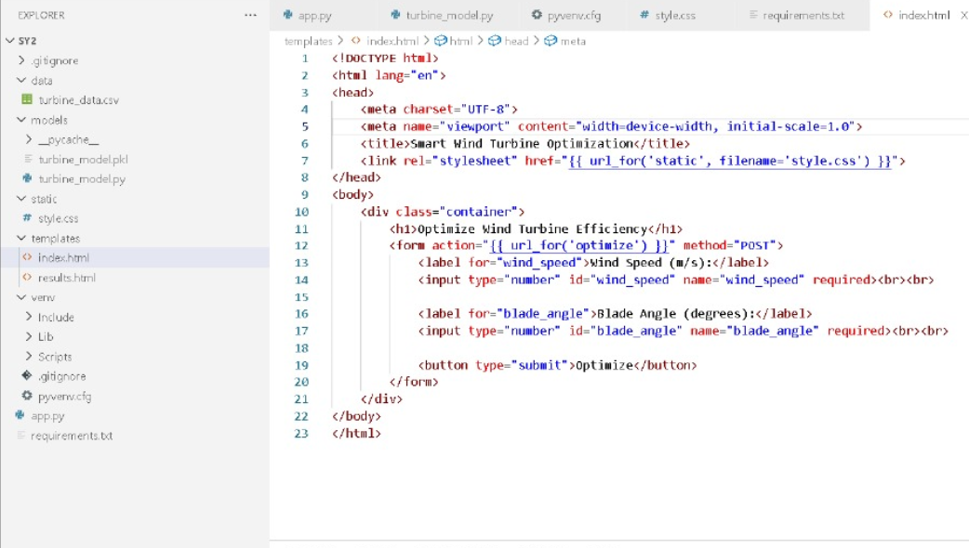
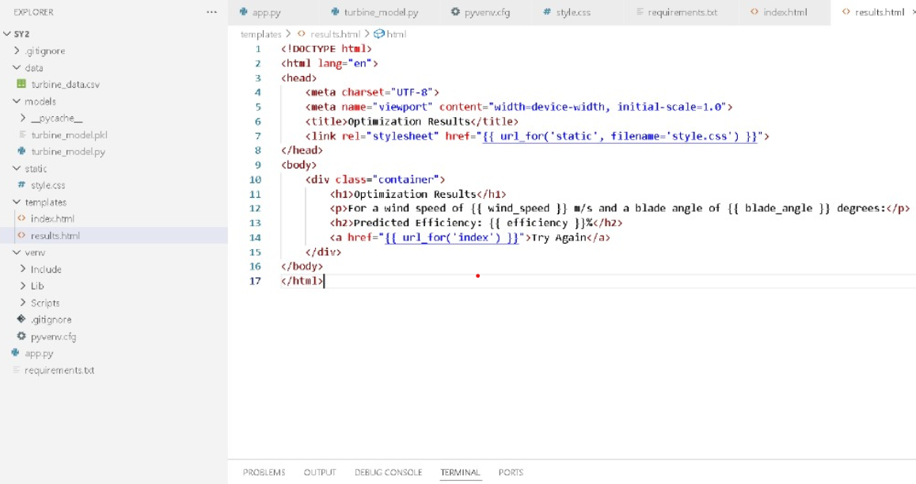
SPARKATHON
7

Slide 8
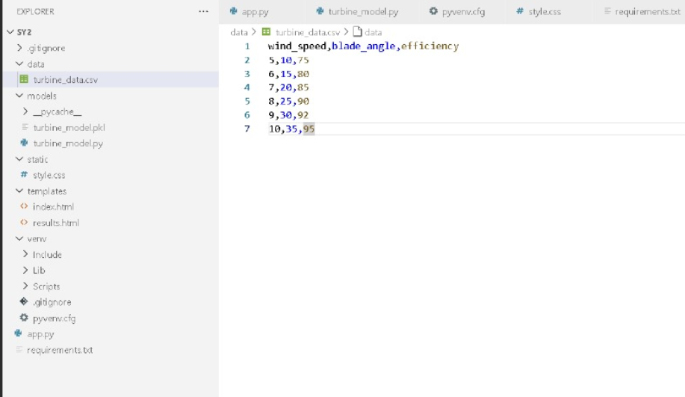
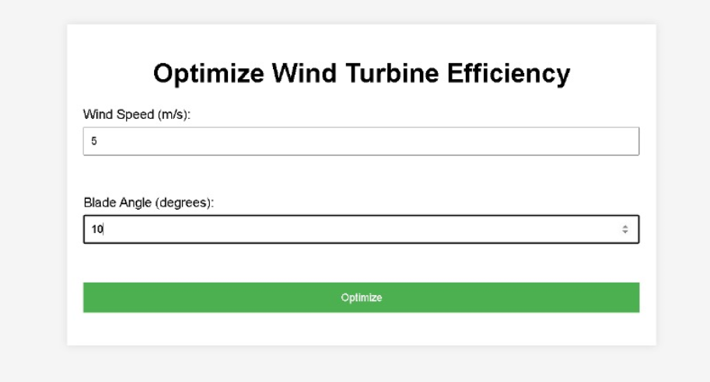
SPARKATHON
8

Slide 9
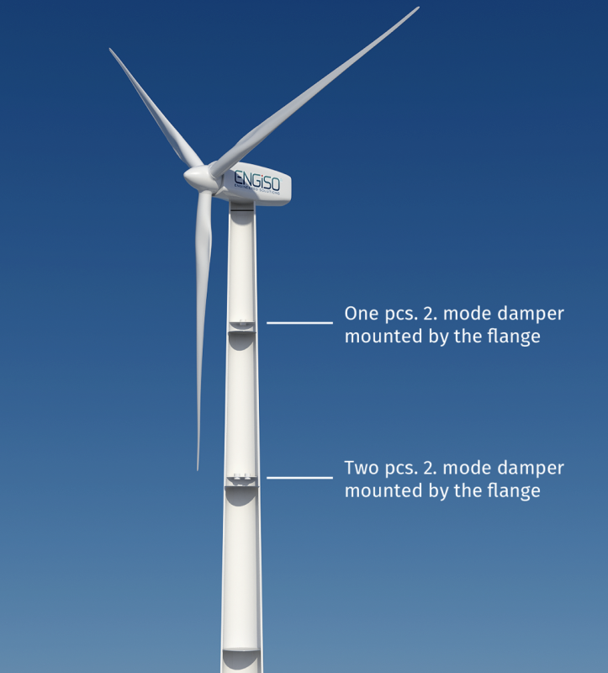
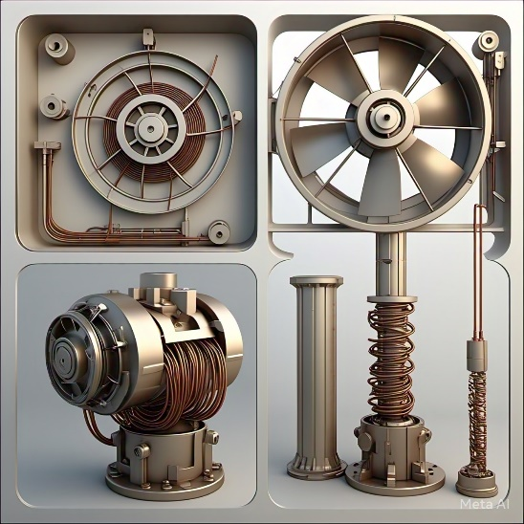
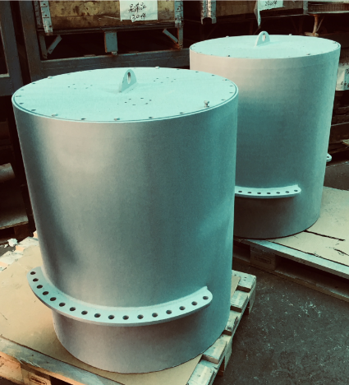
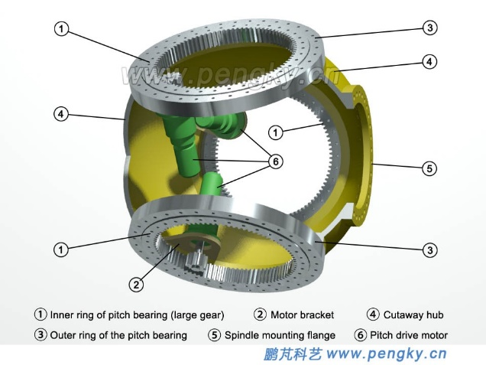
FEASIBILITY AND VIABILITY
Feasibility
Technically feasible with AI-driven control, adaptive blades, and IoT-based real-time monitoring. Economically viable due to long-term cost savings, despite high initial investment. Environmentally sustainable, reducing material waste and optimizing energy efficiency. Operationally efficient with AI optimizing power generation and predictive maintenance.
Regulatory compliance is required, but increasing demand for smart renewables supports market feasibility.
Wind Turbine Nacelle
Challenge
The main challenge is to fix the lens , paint or by heater to produce more energy becomes a critical issue. More noise and battery storage.
There are three solutions to address this challenge, first, the lens , paint or heater can be fixed in the turbine manually. This makes the turbine to produce more energy.
Firstly, fixing the lens , paint , or heater to produce more energy.
Second, due to noise reduction dampers are used to reduce the noise.
Thirdly, using lithium-battery to store energy.
Noise dampers
Nacelle rotation
SPARKATHON
9

Slide 10
IMPACT AND BENEFITS
Impacts
1. Increased renewable energy production: AI-optimized wind turbines can generate more electricity, reducing reliance on fossil fuels and lowering greenhouse gas emissions.
2. Improved energy efficiency: AI-optimized wind turbines can increase energy production by up to 5%, reducing energy costs and increasing revenue for wind farm operators.
3. Predictive maintenance and reduced downtime: AI-powered predictive maintenance can reduce downtime and increase overall efficiency, minimizing the risk of unexpected failures and reducing maintenance costs.
Benefits
Enhanced Grid Stability: Smart wind turbines can provide grid support services, such as frequency regulation and voltage control, enhancing overall grid resilience.
Increased Revenue: Optimized energy production, reduced maintenance costs, and improved grid stability increase revenue for wind farm operators.
Reduced Carbon Footprint: Smart wind turbines with AI efficiency and optimization minimize energy waste, reduce carbon emissions, and promote sustainable renewable energy production.
10

Slide 11


RESEARCH AND REFERENCES
Findings | Reference Link
About Smart wind turbine | https://youtu.be/ia1LJE9sOxQ?si=jkNGgBVYEx0vMGiH
It tell how to control the pitch control | https://youtu.be/LDRHZ5ry-Ts
It tell how to control the yaw control | https://youtu.be/ecT4HvZnaLE
Working of wind turbine | https://youtu.be/LNXTm7aHvWc
TEAM LEADER:
MYTHILI M TEAM MEMBER:
SUBHASHINI S
YUKHADHARSHINI S
VISHALI B
11

Slide 12

Sparkle
SPARKATHON
12

